Slide 1
ShurrFinancial ATM Program
Another new revenue stream

Slide 2
ATM STATISTICS
2013 Federal Reserve Payments Study
5.8 billion ATM withdrawals
1.9 billion from non-FI ATMs
$685.1 billion in volume
Average withdrawal is $118

Slide 3
MERCHANT BENEFITS
New revenue stream from ATM surcharge
Same benefits as traditional card processing (give customers access to money) without the related costs
No processing fees
No monthly minimums*
No retrieval or chargeback fees
Reduced PIN-based fees at the point of sale
Cash retention

Slide 4
ShurrFinancial ATM
Turn-key solution
Hardware, deployment and transportation services
Installation and training
Multiple connectivity options
Online reporting
Vault cash and armor car solution

Slide 5
CONNECTIVITY OPTIONS
Traditional Dial Up
Dedicated phone line
Reduced cardholder concerns
Remote diagnostics
IP Solution
Router – dial to IP converter
Same ATM – connects to existing DSL or cable connection
No additional transaction fees
Wireless ATMs
Router – dial to wireless converter
Same ATM – transactions transmitted via AT&T cellular network
Additional service fees apply

Slide 6
SETTLEMENT OPTIONS
Merchant Cash
Merchant stocks machine
Rapid replenishment of dispensed funds – 48 hour cycle
Stock as often as needed
Most merchants opt for this solution
NAB/SF Vault Cash
NAB/SF handles all cash management
Additional hardware required
Additional service fees
Ideal for arenas, airports, hospitals

Slide 7
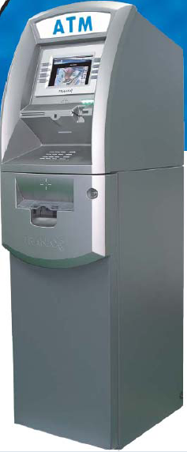
PROGRAM OVERVIEW
Hantle 17005w ($2,300.00)
Height: 56" Width : 17" Depth : 23” Weight: 206 lbs
ADA compliant
Visa encrypting pin pad
Thermal printer
Removable 1000 note cassette
IP and dial-up connectivity
Full 7” color display

Slide 8
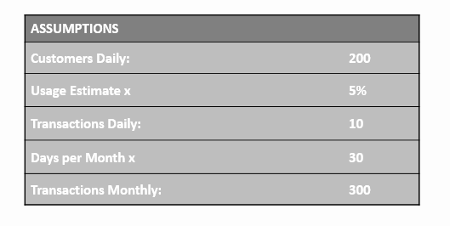
ASSUMPTIONS

Slide 9
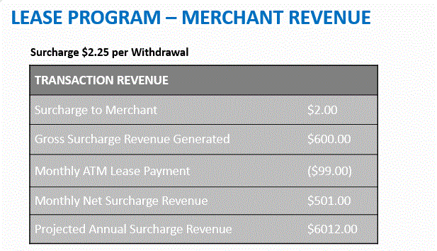
Leasing

Slide 10
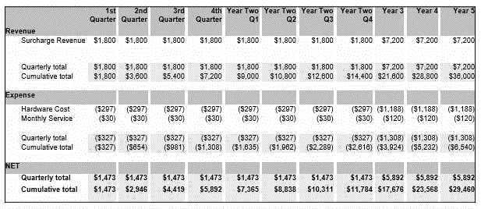
ROI – ATM LEASE

Slide 11
PROGRAM OVERVIEW

Slide 12
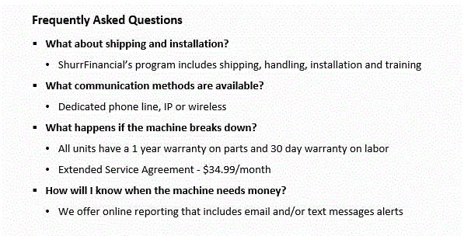
PROGRAM OVERVIEW

Slide 13
PROGRAM OVERVIEW

