Slide 1
“Emergency Alert Buddy” system Virginia gompertz Neighbor to Neighbor Assistance: Emergency Alert Buddy (Supplement to CodeRED)

Slide 2
“Emergency Alert Buddy” system
Purpose of an Emergency Alert Buddy:
To quickly communicate and ensure participating neighbors are aware of a Nevada County CodeRED Emergency Alert (“Prepare to Evacuate,” or “Immediate Mandatory Evacuation”).
Completely voluntary buddy system (member-to-member assistance).
Mutually agreed upon by each participating neighbor.
No one participating is a professional First Responder. If you have a medical emergency, call 911.

Slide 3
“Emergency Alert Buddy” system
Why have an Emergency Alert Buddy?
Your CELL PHONE may be the only form of quick communication if the power is out and your phone system (cell and/or landline) needs electricity or the internet to work.
“Cross-Pollinate” phone carriers and visibility in neighborhood.
During a fire, a cell phone tower (from ATT, Verizon, Sprint, T-Mobile, etc.) could be down.
One neighbor may see a fire down the street while the other neighbor can’t.

Slide 4
“Emergency Alert Buddy” system
How it Works:
Establish 2 – 3 “Emergency Alert Buddies” who agree to be mutually responsible for contacting each other.
If possible, choose your neighborhood’s Alert Buddies who have:
A landline that works if the power is out.
Different cell phone carriers.
Consider a buddy that lives on the other end of the street. One home may see a fire, while the other one can’t.
Consider a 3rd or 4th buddy that lives in another part of Lake Wildwood. Neighbors who live on Wildwood Drive were alerted by honking horns. Others did not hear the horns during the last evacuation.

Slide 5
“Emergency Alert Buddy” system
How it Works (cont.):
During High Fire Season, keep your cell phone nearby, charged and ON. Have a back-up battery for when the power goes out.
When you receive CodeRED Emergency Alert (text or call from 1-866-419-5000):
Call your Emergency Alert Buddy to inform them of the Alert.
If they don’t answer and you have time, knock on their door until they answer it. Inform them of the Alert.
Ask your buddy if they need assistance in getting out of their home or need a ride.
Follow Evacuation Routes recommended by Sheriff/Fire Department.
If you have time, HONK YOUR CAR HORN (or an Air Horn) DRIVING THE STREET
TO WAKE UP OTHER NEIGHBORS – So they can review their CodeRED Alerts too.

Slide 6
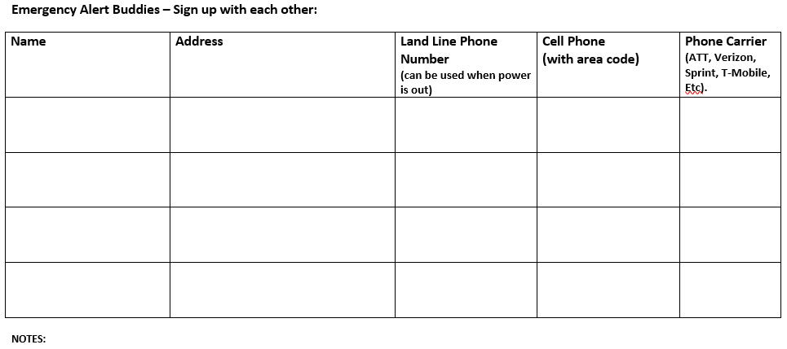

Slide 7
Q&A

